Slide 1
RAM Analysis
01/30/2019

Slide 2
RAM analysis
Acquisition tools:
DumpIt
FTK Imager
Analysis
Volatility (preferred tool)
Bulk extractor

Slide 3
RAM acquisition
What is the SWAP area?
Overview of volatility
Using volatility

Slide 4
Volatility
Open collection of tools, for the extraction of digital artifacts from volatile memory (RAM samples).
Supports analysis for Linux, Windows, Mac and Android systems.
Runs in Windows and Linux (Kali)

Slide 5
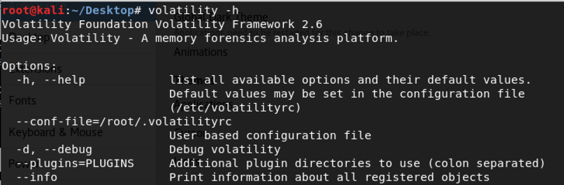
Help

Slide 6
Before using volatility on image
Select a profile:
Volatility needs to know what operating system was imaged in order to interpret the memory image correctly.
Set a profile to tell Volatility what operating system the dump came from, such as Windows XP, Windows 10

Slide 7
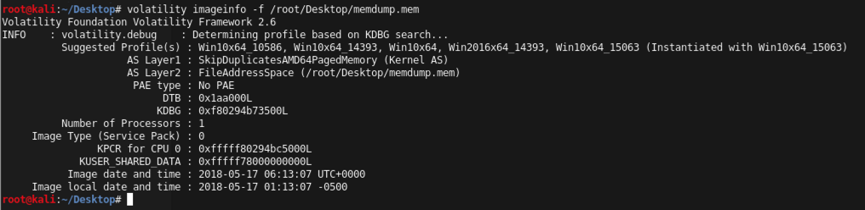
imageinfo

Slide 8
kdbgscan
imageinfo provides profile suggestions,
kdbgscan is designed to positively identify the correct profile and the correct KDBG address

Slide 9
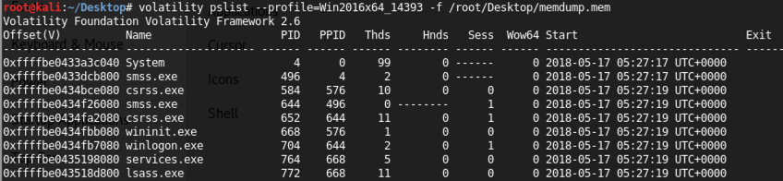
Running processes

Slide 10
output
Offset : The location in RAM of the process, in hexadecimal
Name : The process name, as it would be shown in Task Manager
PID : The process ID
PPID : The parent process ID--that is, the process that launched this process. In the example above, the "System" process is process 4, and it is the parent of the "smss.exe" process.

Slide 11
Searching for process
If we know the processes, we can search for a specific process eg notepad.
# volatility -f test.raw --profile=Win7SP1x86_23418 pslist | grep notepad
Volatility Foundation Volatility Framework 2.6
0x85872b18 notepad.exe 2796 2168 5 81 1 0 2018-03-01 14:01:51 UTC+0000
Then dump the process memory:
# volatility -f test.raw --profile=Win7SP1x86_23418 memdump --dump-dir=./ -p 2796
Volatility Foundation Volatility Framework 2.6 ************************************************************Writing notepad.exe [ 2796] to 2796.dmp
Finally perform a strings search in the dump, using a word of the text as key:
# strings -e l ./2796.dmp | grep "Some"
Some text typed into notepad window!
the “-e l” switch is needed because notepad stores text in 16-bit little-endian:

Slide 12
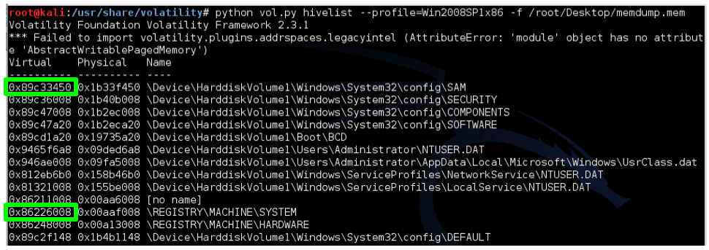
Extracting some password hashes

Slide 13
SYSTEM and SAM hives
To extract the memory hashes, we need to know the start memory locations for the SYSTEM and SAM keys.
The two hexadecimal addresses you found above are used in this format:
-y SYSTEM -s SAM
You will see the login account names and hashed passwords

Slide 14
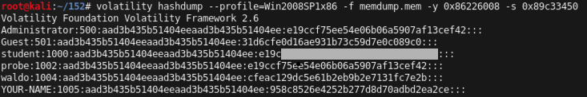

Slide 15
Password hashes
Windows stores two hashes with each password, delimited by colons.
The first one-extremely insecure, obsolete hash using the LANMAN algorithm -Since Vista no longer use LANMAN hashes, so they are filled with a dummy value starting with "aad".
The second hash is the newer NTLM hash, which is much better than LANMAN hashes, but still extremely insecure and much more easily cracked

Slide 16
Cracking the password
Go to
https://crackstation.net/
And crack the password which is partially redacted in the image above.

Slide 17
consoles
searches the memory for commands that attackers entered through a console shell.
The application process handle

Slide 18
Finding malware
What processes were running on the suspect system at the time of the memory acquisition?
Look closely at process 1752. What do you notice? Who is the parent?

Slide 19
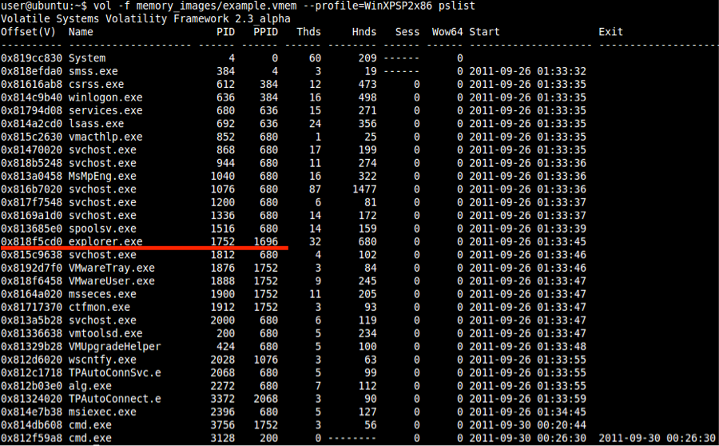
How to find malware

Slide 20
PID
A parent process ID (PPID 1696) that is not listed and has spawned a few other processes.
Lets look at network connection

Slide 21
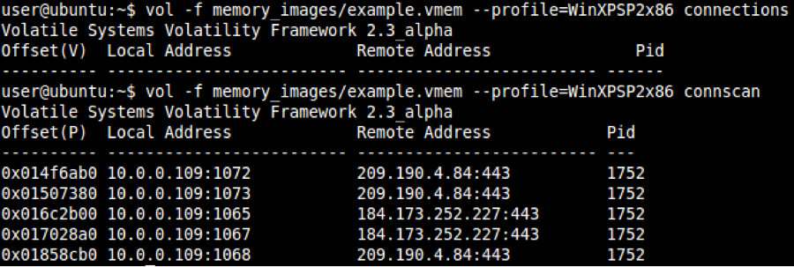
Network connections

Slide 22
Whois??
Whois 209.190.4.84

Slide 23
procdump
Dump the process to an executable file
volatility –f [image]–profile=[profilename] procdump –p [PID] –D [location]
Run it through VirusTotal

Slide 24
psxview
aids in discovering hidden processes

Slide 25
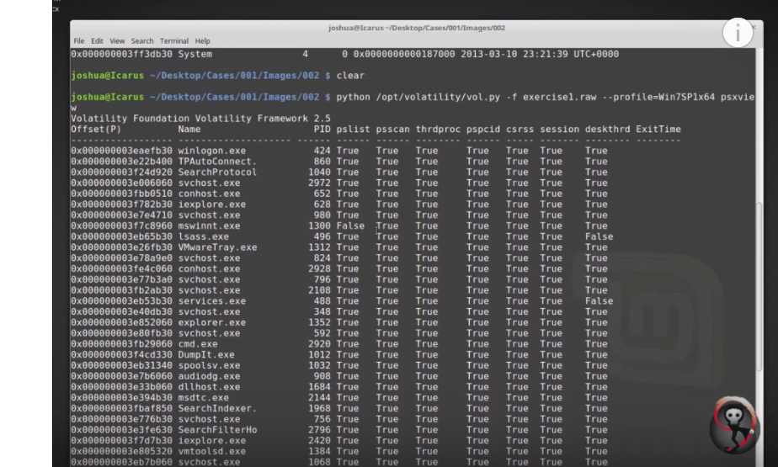
Suspicious processes

